Slide 1

“Capstone Project”
Submitted by: Hritik Londhe
Submission type : Individual
Name: Hritik Londhe
Batch : HDFC API Batch-1
LMS Id :
Program : API Developer
Date: 27-April-2023

Slide 2

TABLE OF CONTENT
Introduction
Project Overview
Architecture Design
Back-end Development
Testing(Output)
Deployment
Conclusion
Future Work
References
Appendices

Slide 3
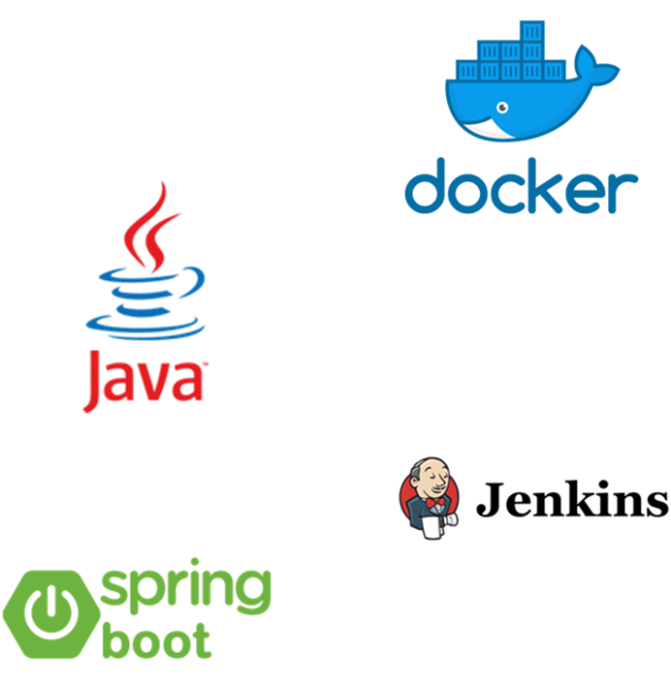
INTRODUCTION
The Employee Management System is a capstone project that aims to address the challenges faced by organizations in managing their workforce efficiently.
The project uses modern technologies like Spring Boot, JPA, MySQL, Docker, and Jenkins to build a robust and scalable system that allows organizations to manage their employees effectively.
This project helps the user to address the GET request, related to management and services

Slide 4
Project Overview
The project involves creating a database table called Employee with three columns: EmployeeID, EmployeeName, and DateOfBirth. A Java program is then written to query a single record based on EmployeeID, and this code is deployed on a Springboot or an Application server like Tomcat or WebLogic.
If the EmployeeID does not match any record, an invalid EmployeeID error is returned. The code is then checked into a version control repository like GIT. Jenkins is used to deploy changes to the code to the Application server.
The Java code is then modified to expose it as an HTTP web service that accepts a single EmployeeID and returns all three fields of the Employee (EmployeeID, EmployeeName, and DateOfBirth). The web service also prints a log file with a date-timestamp for every time it is called, and this log file is rotated when its size exceeds 1 MB.
The web service is tested using Postman, and then it is changed to be exposed as HTTPS instead of HTTP, using a self-signed certificate. A CURL command is written to call the web service, and a separate Java client program is also written to call the web service.

Slide 5
Project Overview
The code of the web service is updated to encrypt the DateOfBirth value using AES-256, and the client program is updated to decrypt this encrypted value. Finally, a containerized version of the web service is created and deployed on Kubernetes, with three instances of the container running.
Technologies used in this project include Java, Spring boot, Tomcat, WebLogic, Jenkins, HTTP, HTTPS, self-signed certificates, AES-256 encryption, Postman, CURL, and Kubernetes.

Slide 6
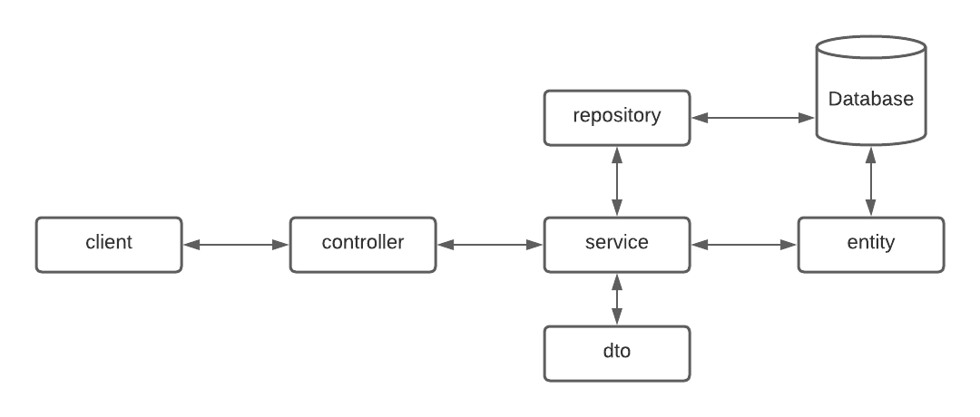
Architecture Design

Slide 7
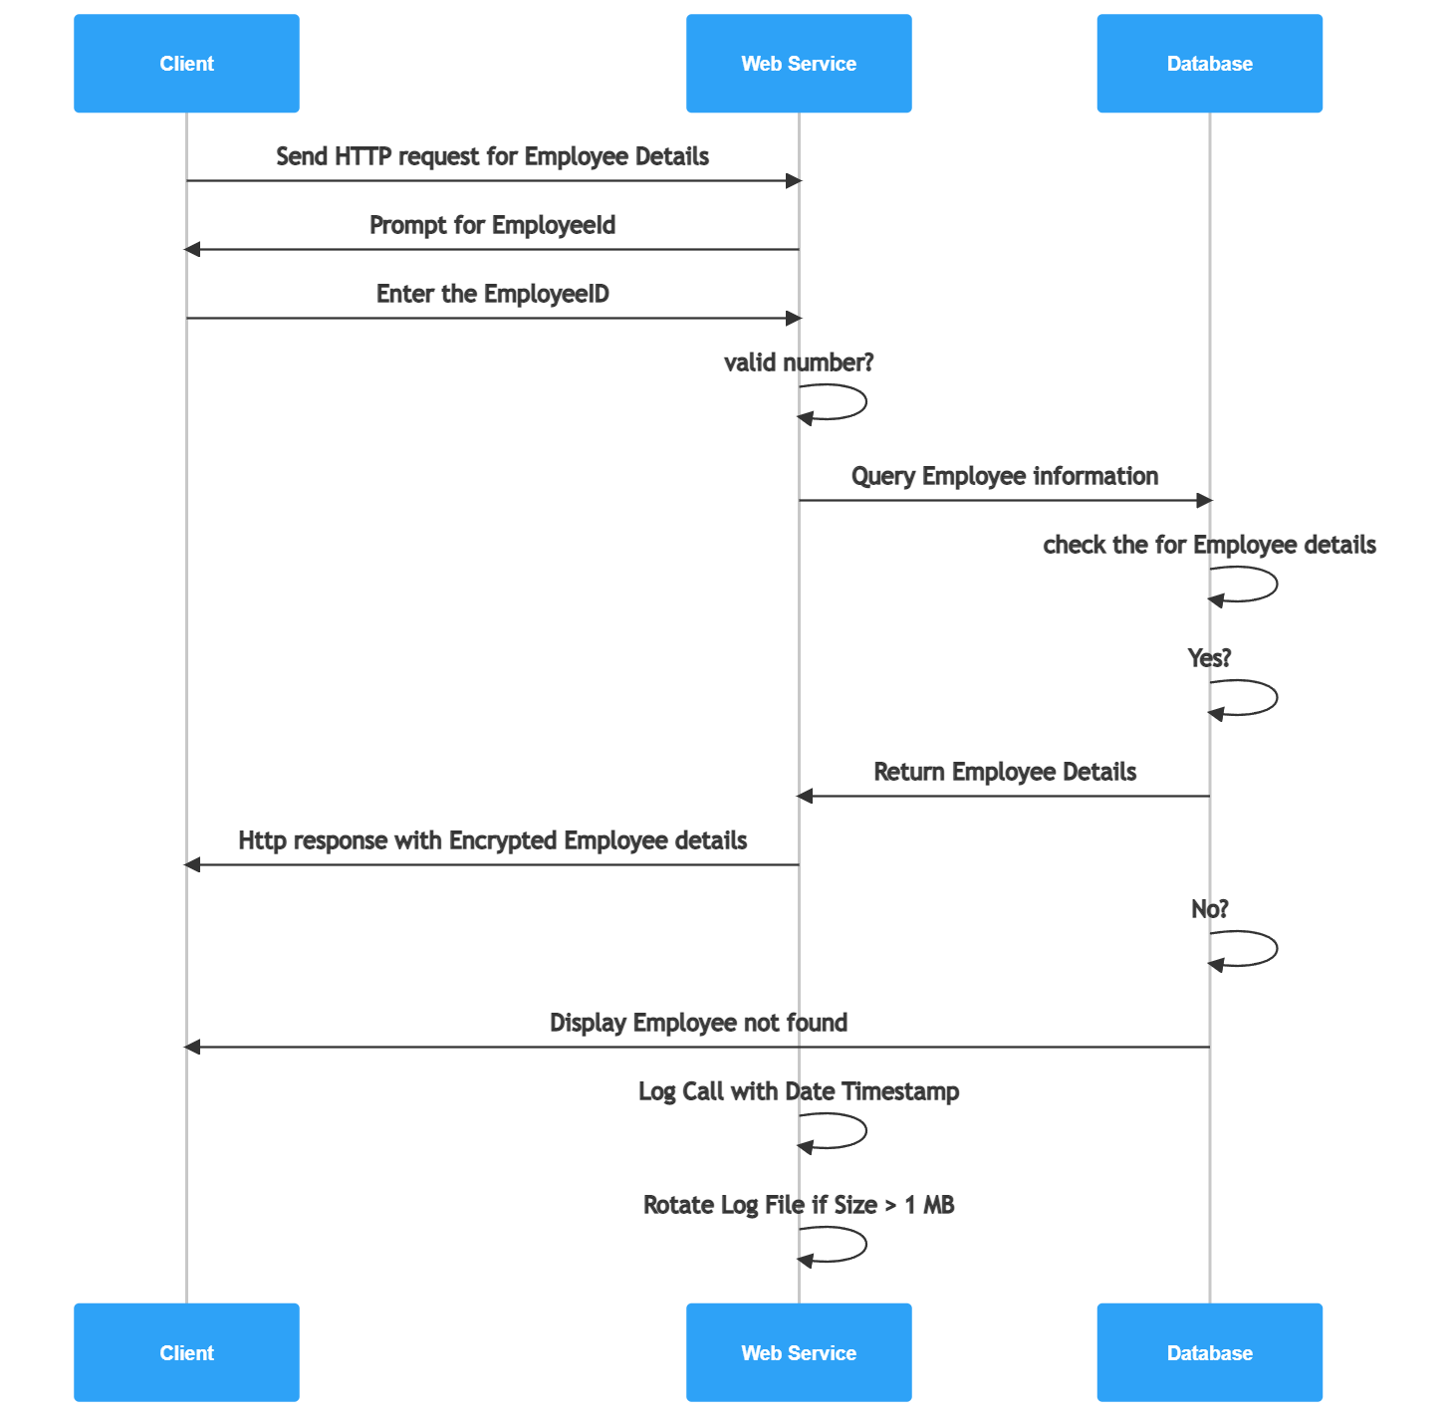
Sequence Diagram

Slide 8
Backend Development
TECHNOLOGY DETAILS:
JAVA
→ The back-end of the application is built using the Java programming language
Spring Boot
→The Spring Boot framework is used to provide a lightweight, modular approach to building web applications in Java
MySQL
The database used for the EMS is MySQL which store the data of Employee
REST API (Representational State Transfer)
→ REST API provides a standard architecture for building web services that can be accessed through HTTP
AES-256 (Advanced Encryption Standard)
AES-256 is a widely-used symmetric encryption algorithm that uses a 256-bit key to encrypt and decrypt data

Slide 9
Backend Development
TECHNOLOGY DETAILS:
Jenkins
→ For continuous Integration with Git Repo and Building of Docker Images
Docker
→ Docker allows for the creation, packaging, and deployment of applications in a lightweight, portable container environment
Kubernetes
→ Kubernetes allows for easy deployment of Docker images to a cluster of nodes.

Slide 10
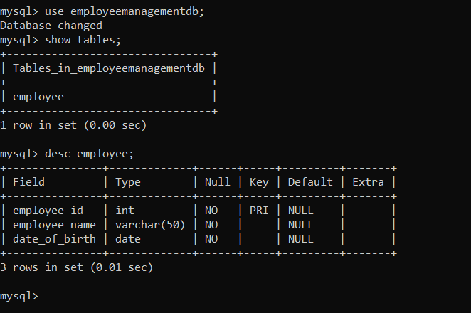
Database
Structure

Slide 11
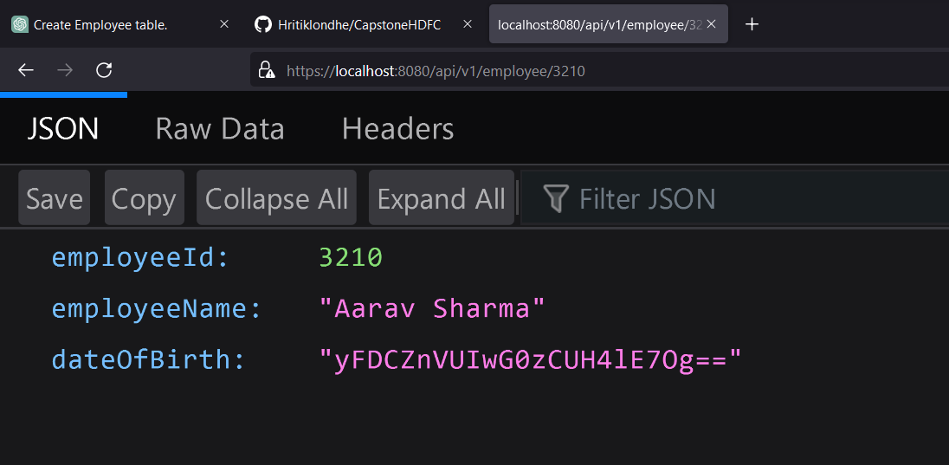
Integration and Testing
Testing Valid web-request and getting the value with Encryption

Slide 12
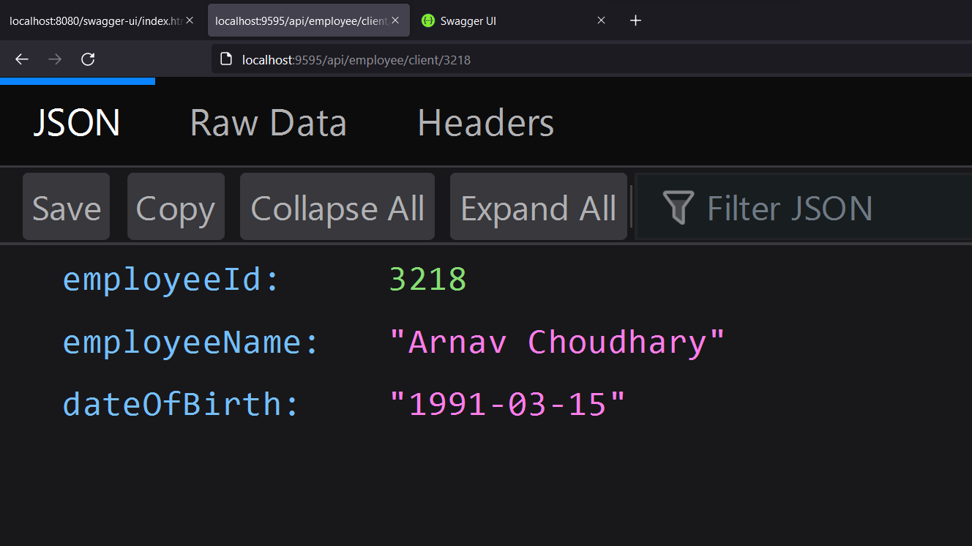
Integration and Testing
Testing Valid web-request and getting the value with Decryption

Slide 13
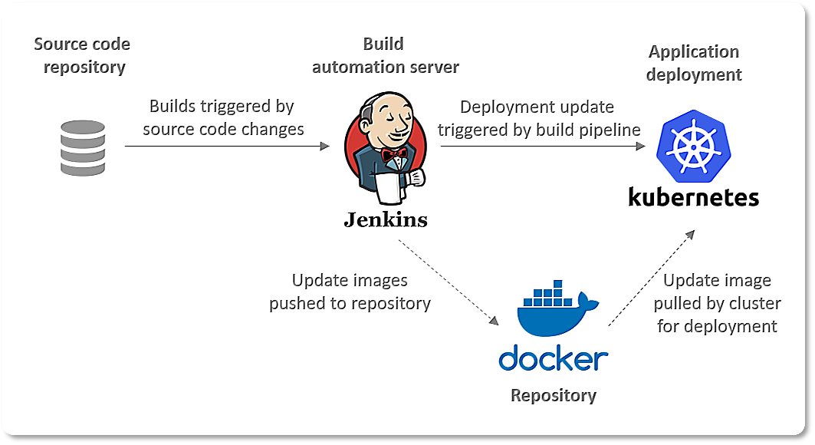
Deployment

Slide 14
Conclusion
The employee management system project demonstrates the use of various technologies such as spring boot, Kubernetes, docker, and encryption techniques like AES-256 to build a secure, scalable, and efficient system for managing employee data.
The project also highlights the importance of continuous integration and deployment using tools like Jenkins, and the significance of securing web services using HTTPS and self-signed certificates.
The project can be further enhanced by adding user interface components to provide a more interactive and user-friendly experience for managing employee data. Additionally, payment processing functionalities can be integrated to enable the system to handle payroll and other financial transactions related to employees.

Slide 15
Future Work
Adding user authentication and authorization to the system to ensure that only authorized users can access employee data.
Implementing a user interface that allows employees to view and update their own personal information, such as contact details or emergency contact information.
Integrating a payment system to allow employees to view and manage their salary and benefits information.
Implementing a feature that allows employees to submit time off requests and view their vacation time balances.
Adding analytics and reporting features to the system to provide insights into employee productivity, attendance, and other metrics.

Slide 16
References
Spring Framework documentation: https://spring.io/projects/spring-framework
AES256 encryption-decryption reference: https://www.baeldung.com/java-aes-encryption-decryption
HTTPS self-signed certificate reference: https://www.baeldung.com/java-https-self-signed-certificate
Jenkins: https://www.jenkins.io/
Docker: https://www.docker.com/
Kubernetes: https://kubernetes.io/docs/home/

